Slide 1

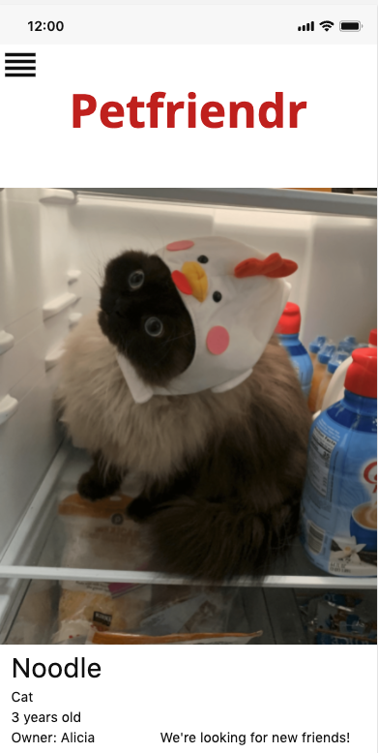
Petfriendr
Amy Moretti
Zoe Riederman
Joe Salemi
Jessica Solis

Slide 2
Project Overview
Notes:
Amy or Jessica will give a quick project introduction for the class since the presentation is kind of meaningless without context.

Slide 3
Use Cases
User Sign-Up
User Searches for Matches
User Sends/Receives Messages
Notes:
Amy talks about use cases

Slide 4
User Sign-Up
Actor: Unregistered user who wishes to make an account
Description: An unregistered user will be able to create an account by providing a few pieces of information.
Pre-Condition: User does not have login credentials Post-Condition: Guest will become a registered user and will now have access to the features of the PetFriendr.
Flow of Events:
User will be brought to the login page of PetFriendr.
User will click on “create account.”
User will be brought to the create account page where he/she will enter the required information: name, username, password, and email address.
User will click submit.
User will now be able to login and add pet information if he/she has a pet.
Alternative Flow: None
Notes:
Amy

Slide 5
User Searches Matches
Actor: A registered user
Description: All registered users will receive potential friend matches. User will indicate whether or not they want to make a connection by swiping right for yes or left for no.
Pre-Condition: User has an active account. Post-Condition: User will have reviewed all of the potential connections and have either rejected or accepted to make a connection.
Flow of Events:
User logs in.
The user is prompted to review potential pet owners or pet lovers to make a connection with.
The user reviews profiles and swipes left to indicate there is no interest in making a connection or swipes right to indicate they want to make a connection if the interest is mutual.
If both the user and the person the user swiped right on connect, user will be able to reach out and vice versa.
Alternative Flow: None
Notes:
Amy

Slide 6
User Sends/Receives Messages
Actor: Two registered users that have matched with each other
Pre-Condition: Users have active accounts and has swiped right on each other. Post-Condition: Users have an active chat box in which to communicate with each other.
Flow of Events:
Users log in.
Each user is prompted to review potential pet owners or pet lovers to make a connection with.
The user sreviews profiles and swipe right to indicate they want to make a connection. If the interest is mutual between the two registered users, the user will be prompted to send a message if he/she wants to initiate the outreach.
Other user receives notification that he/she has an unread message.
User heads to messaging and opens message.
User replies to unread messages he/she wishes to reply to
Alternative Flow: None
Notes:
Amy

Slide 7
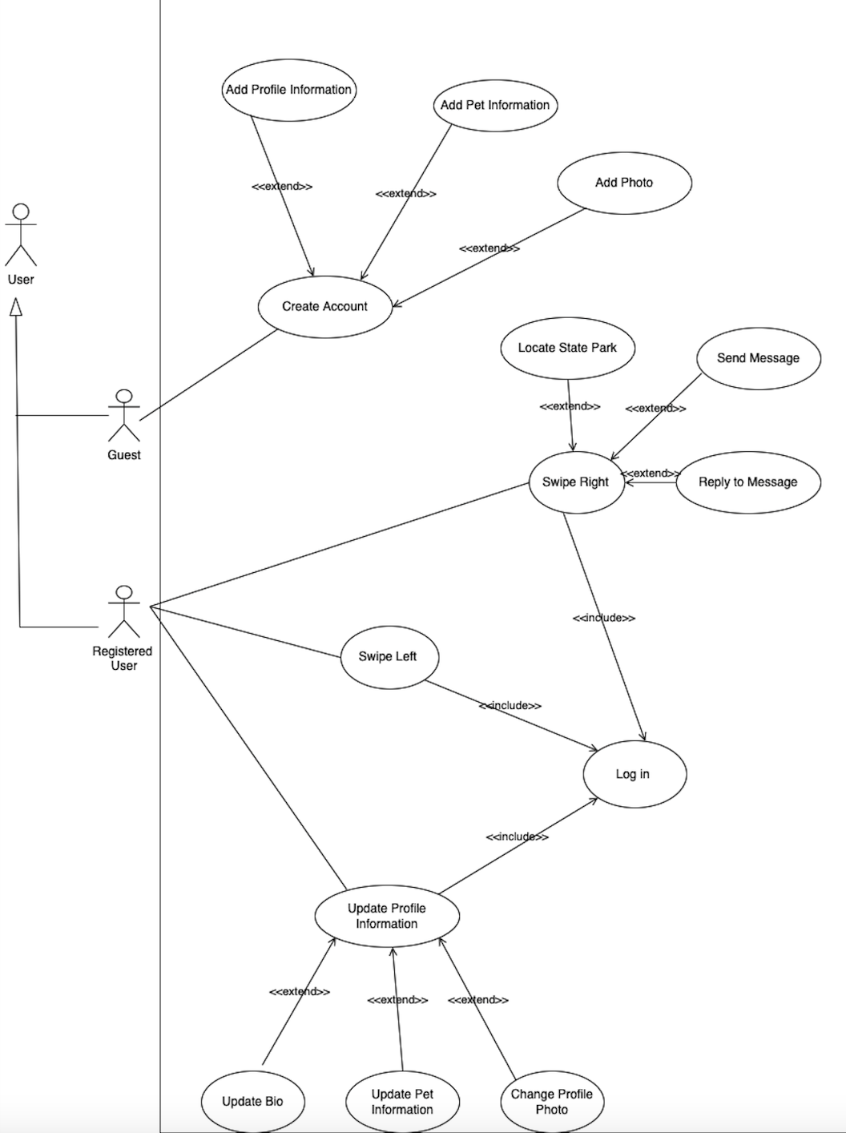
Use Case Diagram
Notes:
Jessica

Slide 8
Class Diagram
Notes:
Joe

Slide 9
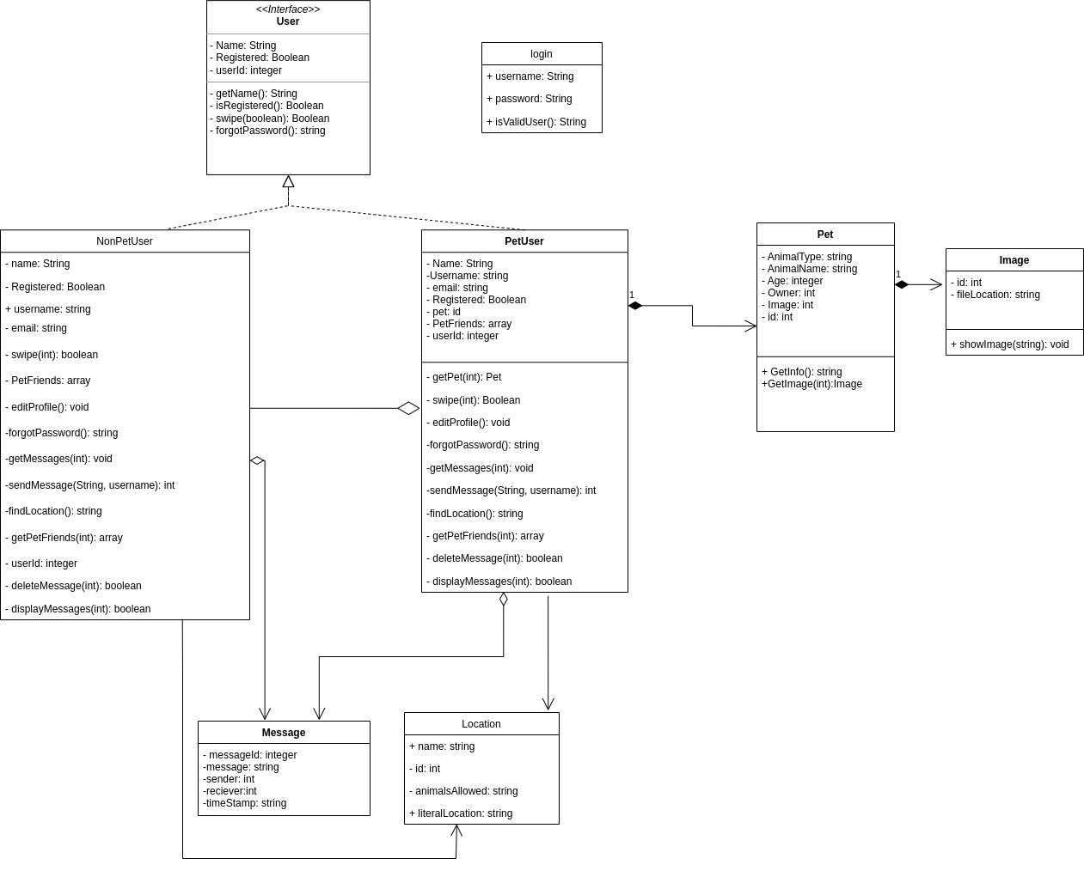
Notes:
Joe

Slide 10
UI Sequence Diagram
Notes:
Zoe

Slide 11
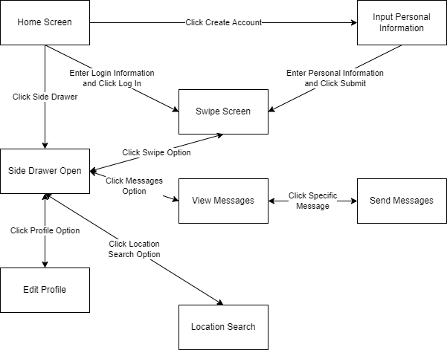
Component Browser
Notes:
Zoe

Slide 12
General Progress Update
Notes:
Amy

Slide 13
What’s Next?
Finalize Requirements
Begin Coding
Notes:
Amy

Slide 14
Questions?
Notes:
Amy

